Slide 1
Introduction to Databases
FLIPPED CLASSROOM – DAY 1
CHECK IN OWL TO SEE YOUR GROUP NuMBER AND SIT WITH YOUR GROUP!

Slide 2
Announcements
All individual assignments are now posted if you want to work ahead
Once you have finished week 3 videos you can complete Assignment 1 (so THIS week, you should be able to complete and hand in assignment 1…be a keener! ☺ )
You can do double time to watch videos faster if you want:
http://www.csd.uwo.ca/~lreid/blendedcs3319/videolectures/week3/hash_edit/hash_edit.html
For assignment 2 and 3, you need to build your virtual machine:
Instructions are in Week 5 or in the Virtual Machine Assignment
You will need a .pem file. Each of you have a different one in your dropbox in Owl.
For assignment 3, you need to the PHP assignment, instructions are there.
Owl.uwo.ca

Slide 3
ANNOUNCEMENTS
Next week → CRA (Canadian Revenue Agency) is coming with free pizza to give a workshop about them and why you might consider working for the government.
I offered them our classroom and timeslot (Tuesday, Oct 1 - 11:30-1:30)
I think some former Western students are coming to talk about working for the CRA

Slide 4
Canadian Revenue Agency (CRA) Tech Showcase
Join the Experts from the Canada Revenue Agency (CRA) as they share the latest in Technology and how it is impacting one of our Government’s most sensitive Departments – And there is FREE PIZZA LUNCH.
Date: Tuesday Oct 1, 2019
Time: 11:30am – 1:20pm
Location: Talbot College (TC) 141
Target 2nd, 3rd and 4th year Computer Science students.
Information about employment opportunities and pizza Lunch provided – https://www.connect.uwo.ca/home.htm
More detail about the workshop:
Representatives from the CRA’s Information Technology Branch will give an in-class presentation focusing on information technology at the CRA that will cover the following topics:
The types of skillsets that the CRA recruits for in Computer Science students
The types of roles that exist for students with Computer Science education
What the future of technology at the CRA looks like and what that means for employment opportunities in IT
The student perspective (hear form a recent grad what it’s like to be a hired as a student and start your career at the CRA).
Showcase some of CRA’s Technology projects such as:
Innovative learning through Gamification
Demonstration of the CRA’s Charlie the Chatbot.

Slide 5
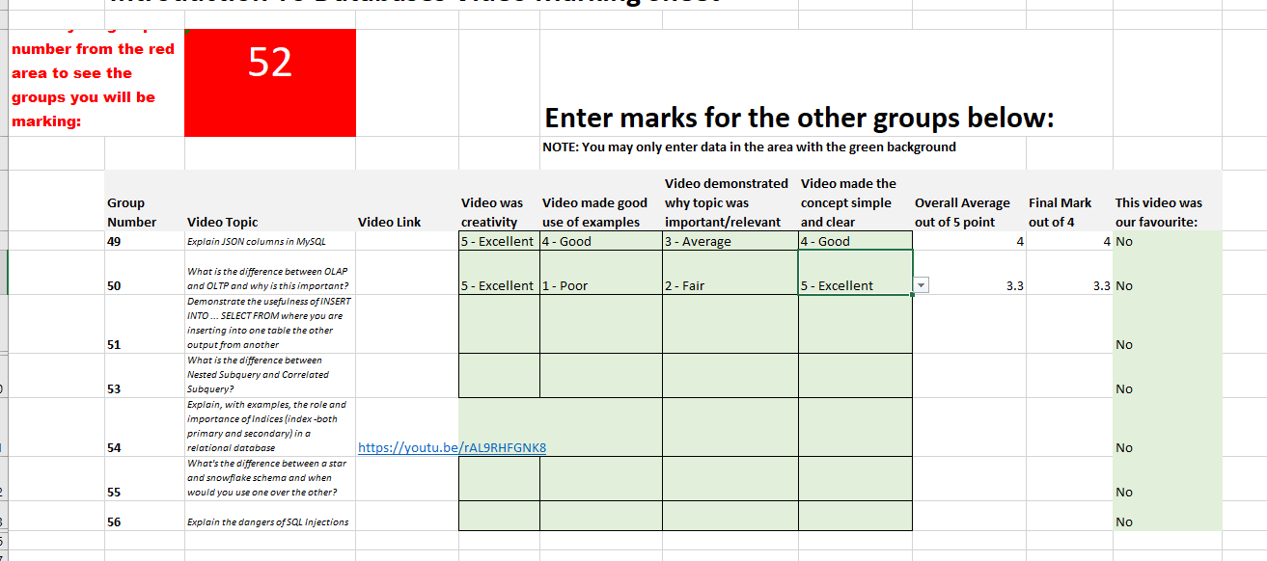
Group Videos
I will post the group video assignment this week.
You can start working on it whenever you want
This classroom is free during our class period AND you are free during our class period so that is a good time to work on the video.
The end of today’s class is your last chance to suggest a topic (email me your suggestion)
High level overview … SHOULD BE EASY TO UNDERSTAND!
Here is the marking sheet from last year:
Here is the awesome one I told you about:
One
Two
Three

Slide 6
TODAY
Sit with your group
Just need pencils today (Flipped 3,4 and 5 you need one laptop)
You get 1 mark for showing up and 1 mark for your answers.
½ way through we will take up the sheets.
At the end of today your group MUST do 2 things to get the marks for today:
1. ONE member in your group must hand in the images of your sheets (take pictures with your phone) via OWL for assignment Flipped Classroom One
2. Hand in the paper copy of your sheets to ME or a TA at the end of the class
Think of one lie and one truth, for example:
Laura has been to Beijing China
OR
Laura has been to Beirut Lebanon
Do this ice breaker with your group while we hand out the papers!

